Slide 1
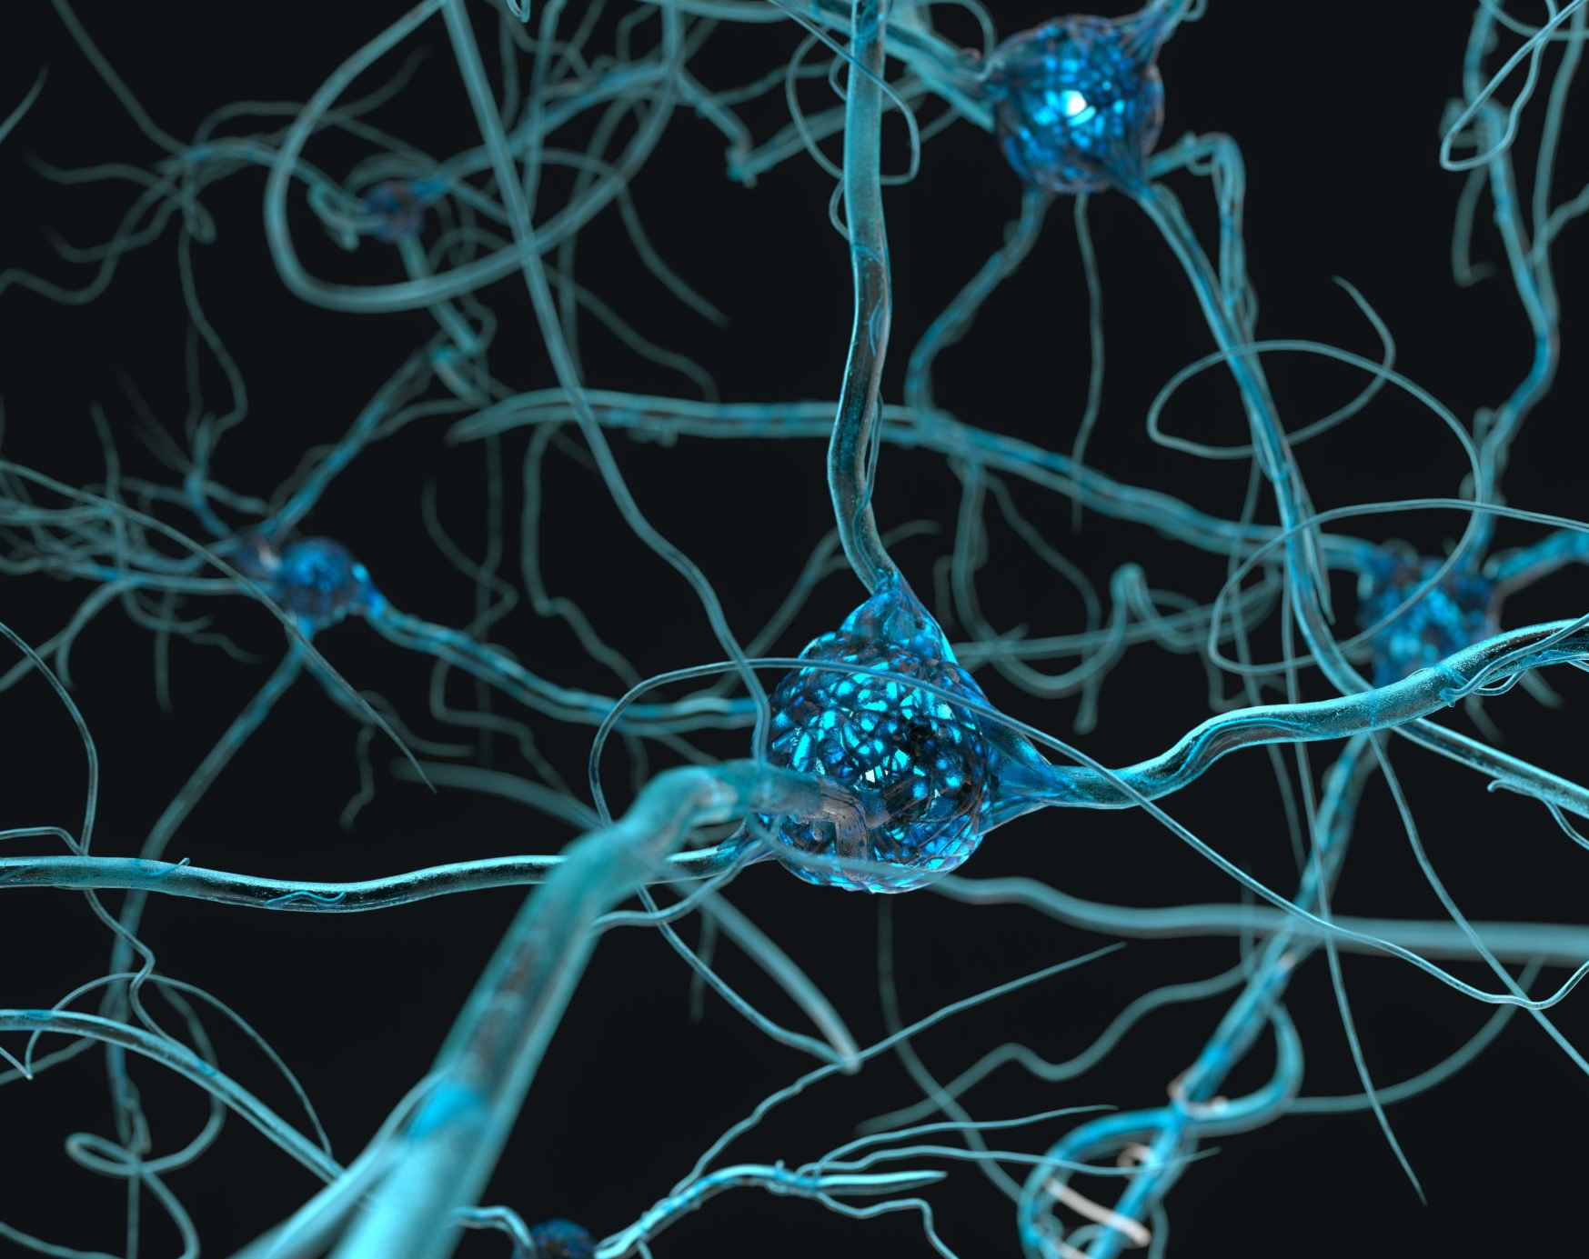
Structure of a neuron

Slide 2
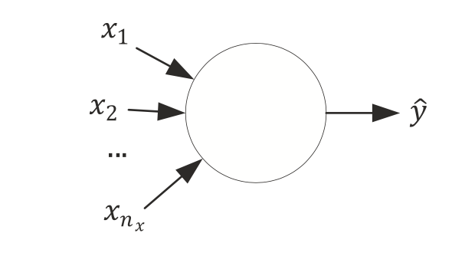
A neuron without details

Slide 3
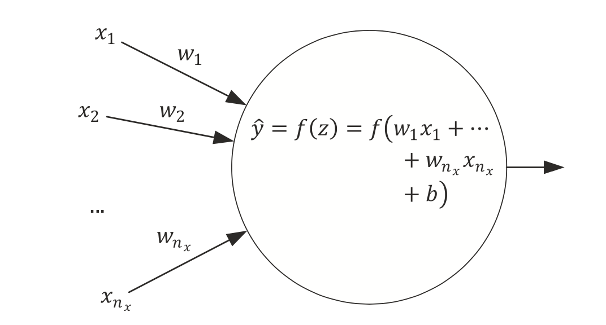
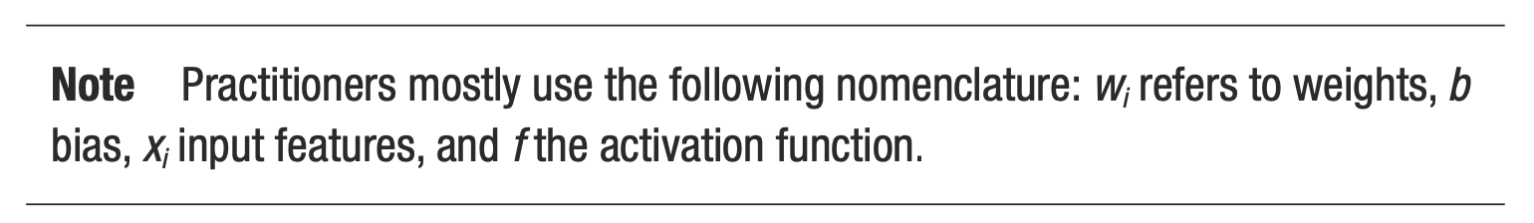
Simplest network possible
The simplest neural network that we can create is made of one single neuron.
Source:Umberto Michelucci, Applied Deep Learning - A Case-Based Approach to Understanding Deep Neural Networks, APRESS 2018

Slide 4
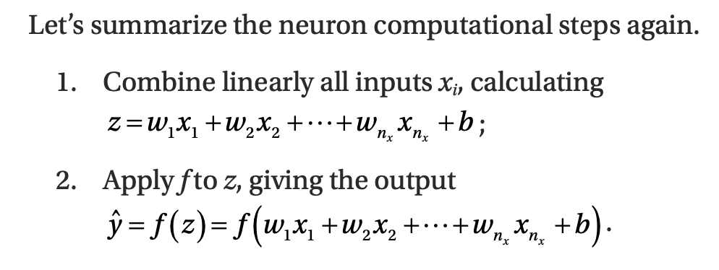
Computational Steps of a single neuron
Weights
Bias
Activation Function
Source:Umberto Michelucci, Applied Deep Learning - A Case-Based Approach to Understanding Deep Neural Networks, APRESS 2018

Slide 5
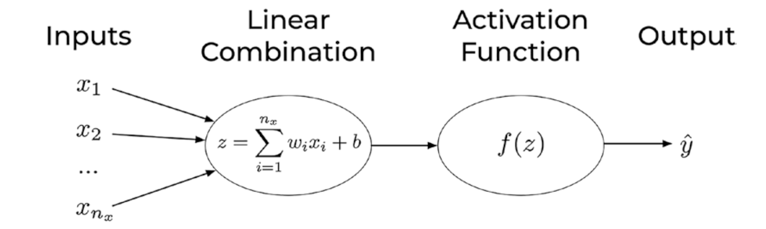
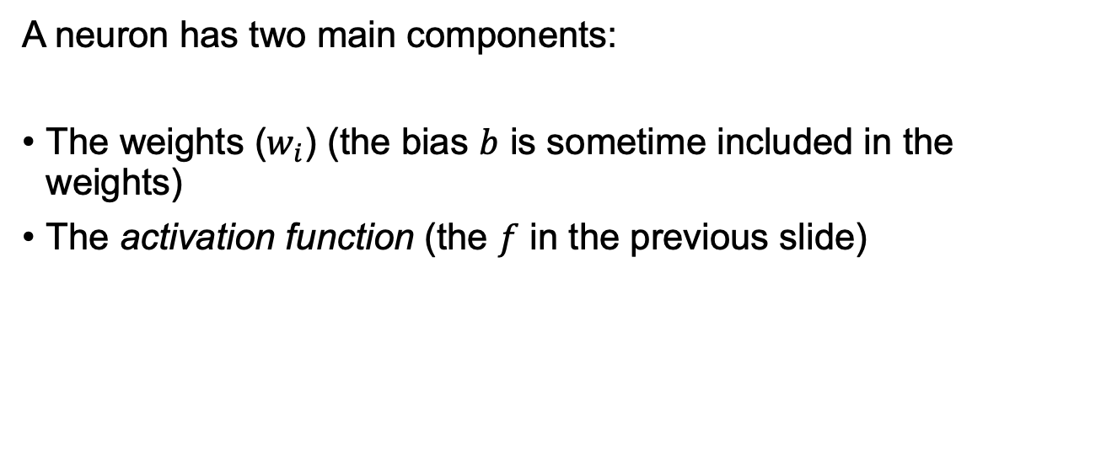
Components of a neuron
A neuron has two main components:
The weights ($w_{i}$) (the bias $b$ is sometime included in the weights)
The activation function (the $f$ in the previous slide)
U. Michelucci, Applied Deep Learning with TensorFlow 2, Springer Nature, 2022

Slide 6
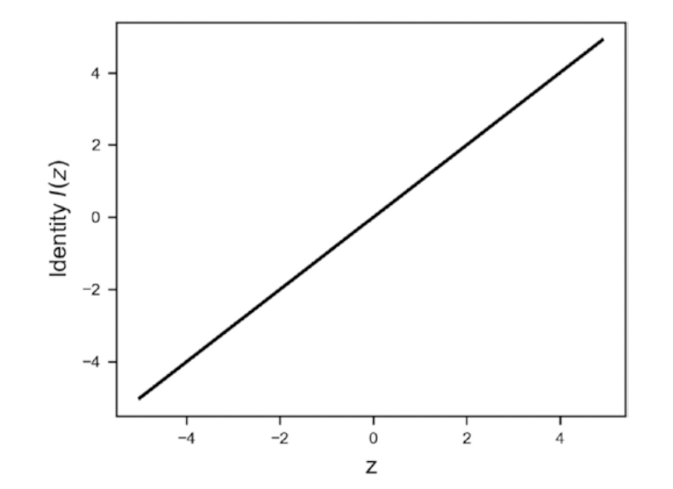
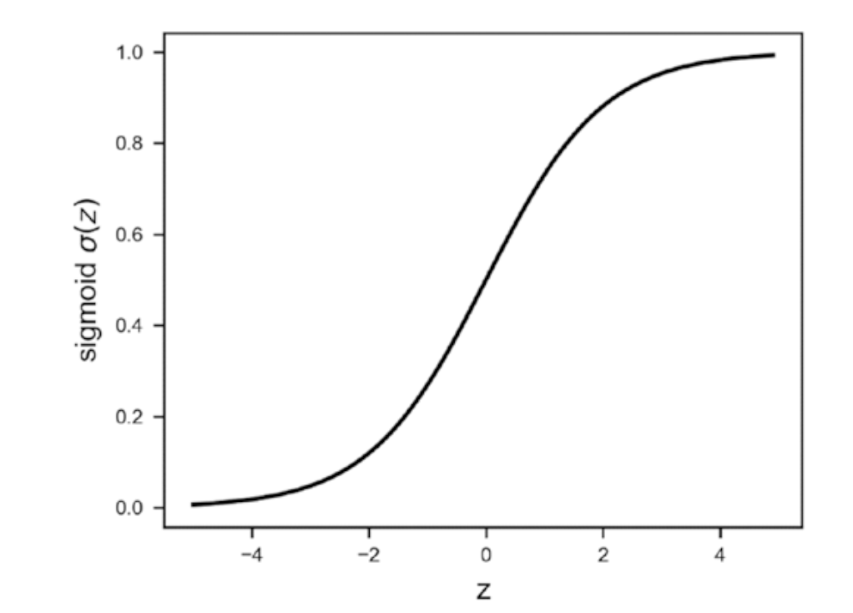
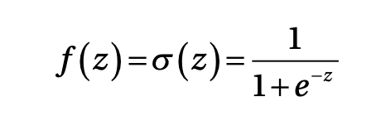
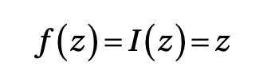
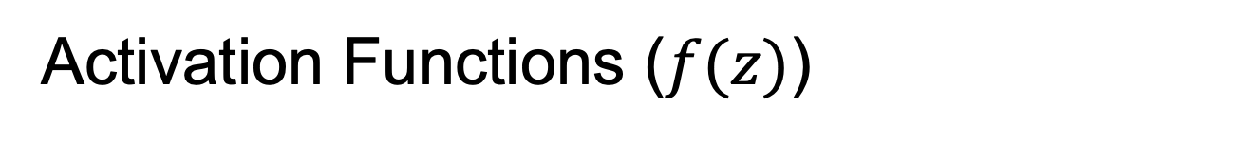
Activation Functions ($f(z)$)
Identity
Sigmoid

Slide 7
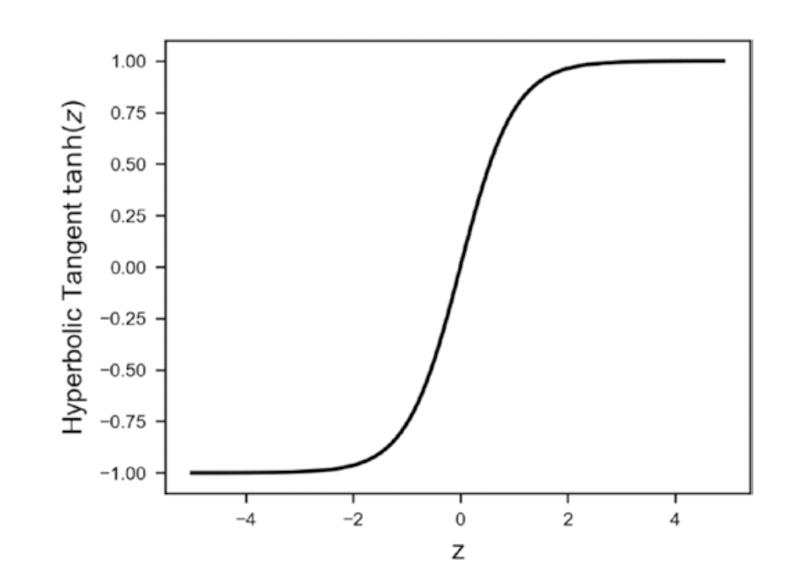
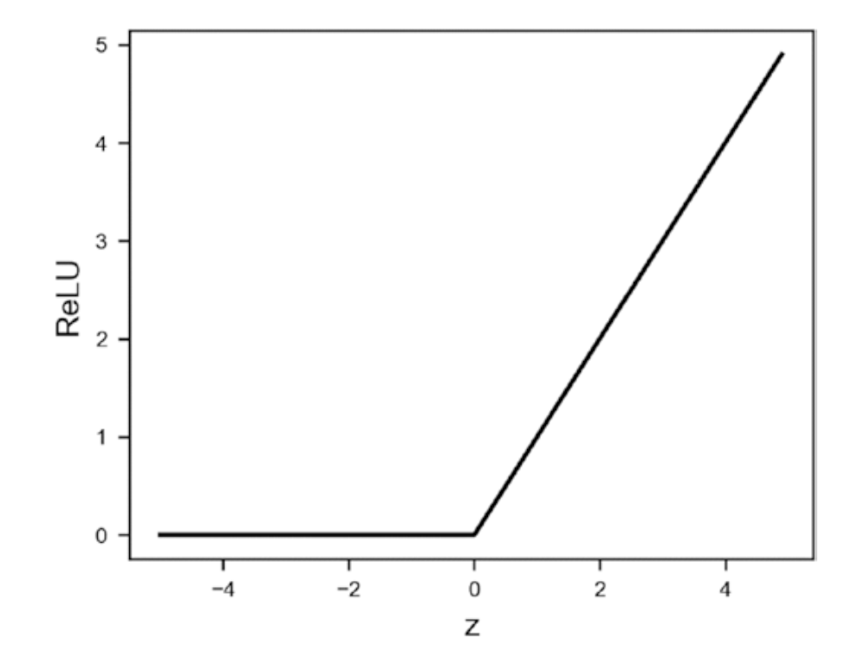
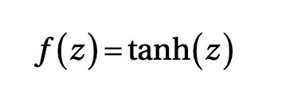
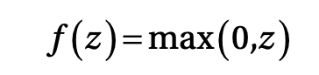
Activation Functions ($f(z)$)
Hyperbolic Tangent
ReLU (Rectified Linear Unit)

Slide 8
Activation Functions ($f(z)$)
Many others:
Leaky ReLU
Swish
ArcTan
Exponential Linear Unit (ELU)
Softplus

Slide 9
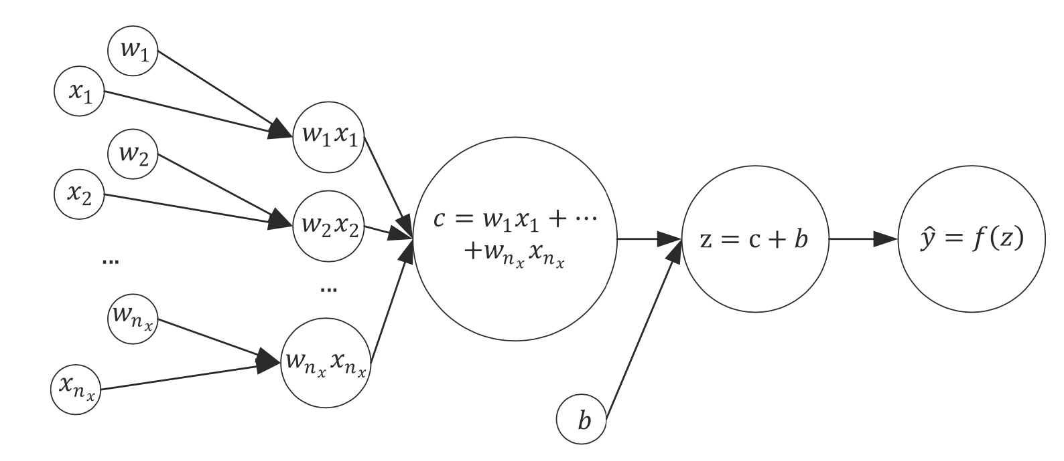
The same network seen as a computational graph
A computational graph is a directed graph where the nodes correspond to operations or variables. Variables can feed their value into operations, and operations can feed their output into other operations. This way, every node in the graph defines a function of the variables. (From: http://www.deepideas.net/deep-learning-from-scratch-i-computational-graphs/)
Source:Umberto Michelucci, Applied Deep Learning - A Case-Based Approach to Understanding Deep Neural Networks, APRESS 2018

Slide 10
What is a tensor (why TensorFlow?)
In its simplest (and somehow incorrect) definition a Tensor is simply a multi-dimensional array of numbers.
An image is a tensor of 3-dimensions (the horizontal and vertical resolution and the colors, RGB).

Slide 11
Learning for a neuron includes 3 components
A neural network (defined by its architecture, in other words the computational steps to evaluate the network output)
A loss function (a function to measure how good or bad the network is predicting the outputs)
An algorithm to minimize the loss function (also called optimizer)
Source:Umberto Michelucci, Applied Deep Learning - A Case-Based Approach to Understanding Deep Neural Networks, APRESS 2018

Slide 12
Quiz: What can a neuron do?
We have discussed how a neuron looks like. But how can a neuron solve any type of problem?
Can a neuron solve a classification and a regression problem? How can we do that?
Question to you: which component of a neuron is responsible for the type of problem we want to solve?
Notes:
Draw on the blackboard all the components of a neuron and the 3 components of a model and ask students which part is relevant

Slide 13
Which portion of a neural network model is responsible for the type of problem that can be solved?
Two main components are responsible for the type of problem that can be solved:
The output activation function
The loss function
→ The optimiser is not related in any way to the type of problem solved.

Slide 14
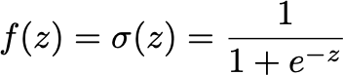
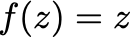
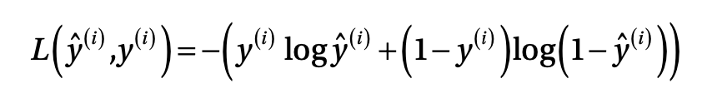
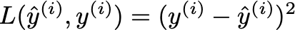
A single neuron can do a lot
Logistic regression (binary classification)
Linear regression

Slide 15
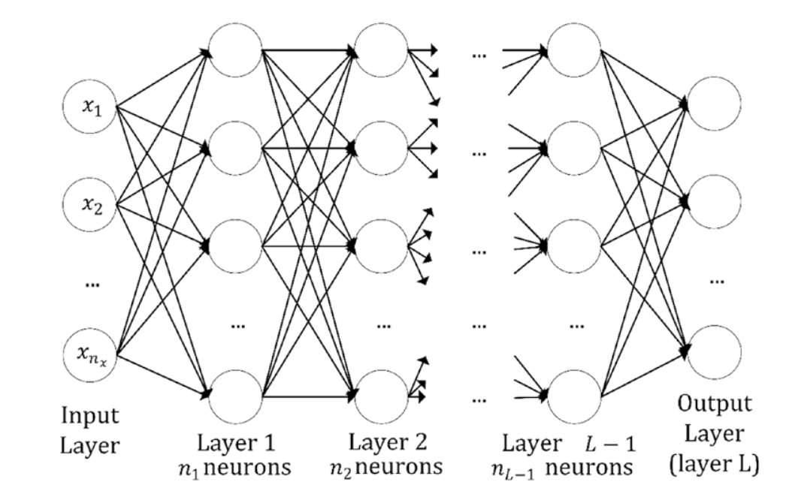
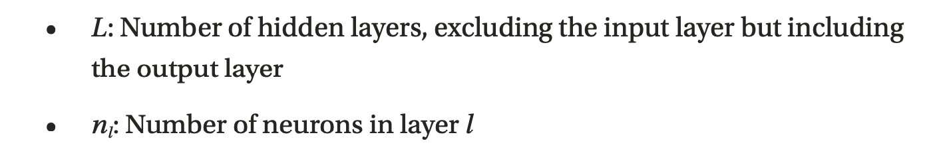
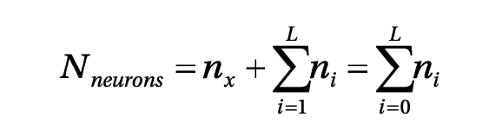
Multiple neurons / multiple layers
Layer (no intra-layer connection)
Quiz: Do you think there is any rule or best practice in deciding how many neurons/layers you should use?
Source:Umberto Michelucci, Applied Deep Learning - A Case-Based Approach to Understanding Deep Neural Networks, APRESS 2018

Slide 16
How to do classification if the output is a real number?

Slide 17
Classification Problem and output activation function The Softmax function

Slide 18
Neural Network Architecture (example with 3 classes)
How should we interpret those numbers?
We would like to interpret them as the probability of the input observation to be in class 1, 2 or 3.
Network
Input

Slide 19
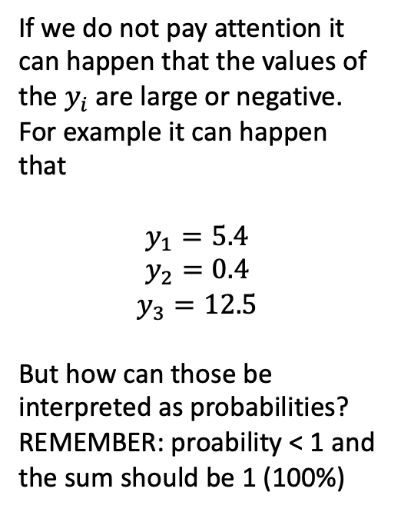
Neural Network Architecture (example with 3 classes)
If we do not pay attention it can happen that the values of the $y_{i}$ are large or negative. For example it can happen that
$$y_{1}=5.4$$
$$y_{2}=0.4$$
$$y_{3}=12.5$$
But how can those be interpreted as probabilities? REMEMBER: proability < 1 and the sum should be 1 (100%)
Network
Input

Slide 20
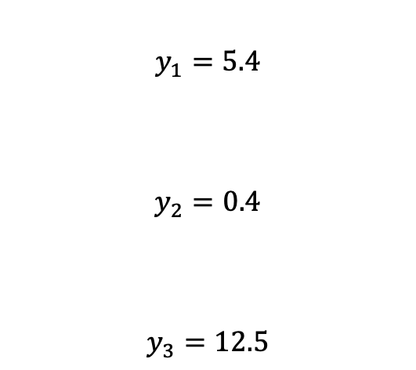
Neural Network Architecture (example with 3 classes)
$$y_{1}=5.4$$
$$y_{2}=0.4$$
$$y_{3}=12.5$$
Network
Input

Slide 21
Neural Network Architecture (example with 3 classes)
Network
Function
Input

Slide 22
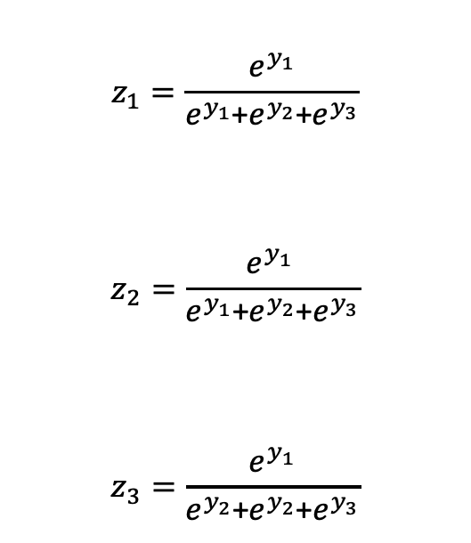
Neural Network Architecture (example with 3 classes)
$$z_{1}=\frac{e^{y_{1}}}{e^{y_{1}}\text{+}e^{y_{2}}\text{+}e^{y_{3}}}$$
$$z_{2}=\frac{e^{y_{1} }}{e^{y_{1}}\text{+}e^{y_{2}}\text{+}e^{y_{3}}}$$
$$z_{3}=\frac{e^{y_{1}}}{e^{y_{2}}\text{+}e^{y_{2}}\text{+}e^{y_{3}}}$$
Function

Slide 23
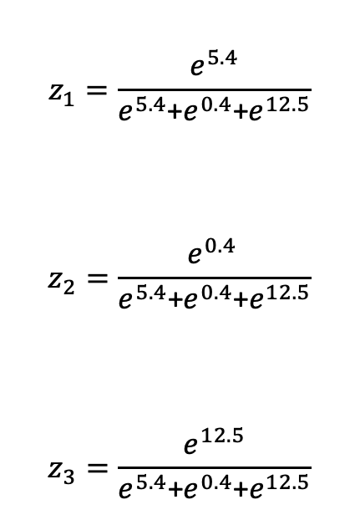
Neural Network Architecture (example with 3 classes)
$$z_{1}=\frac{e^{5.4}}{e^{5.4}\text{+}e^{0.4}\text{+}e^{12.5}}$$
$$z_{2}=\frac{e^{0.4 }}{e^{5.4}\text{+}e^{0.4}\text{+}e^{12.5}}$$
$$z_{3}=\frac{e^{12.5}}{e^{5.4}\text{+}e^{0.4}\text{+}e^{12.5}}$$
Function

Slide 24
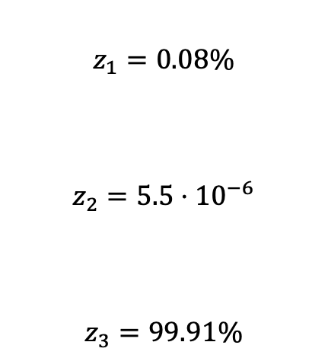
Neural Network Architecture (example with 3 classes)
$$z_{1}=0.08\%$$
$$z_{2}=5.5⋅{10}^{−6}$$
$$z_{3}=99.91\%$$
Function

Slide 25
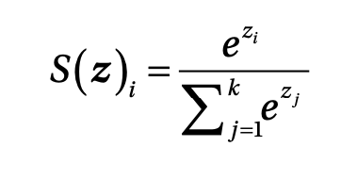
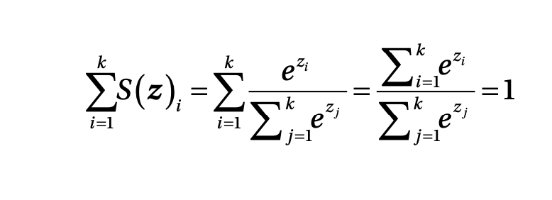
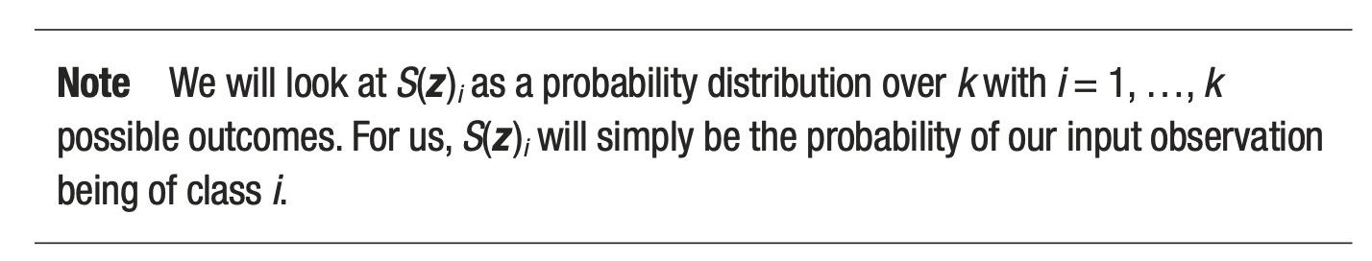
Softmax output layer for classification
Output of ith neuron of the output layer
Note that they can be interpreted as probability since the sum is equal to 1
Source:Umberto Michelucci, Applied Deep Learning - A Case-Based Approach to Understanding Deep Neural Networks, APRESS 2018

Slide 26
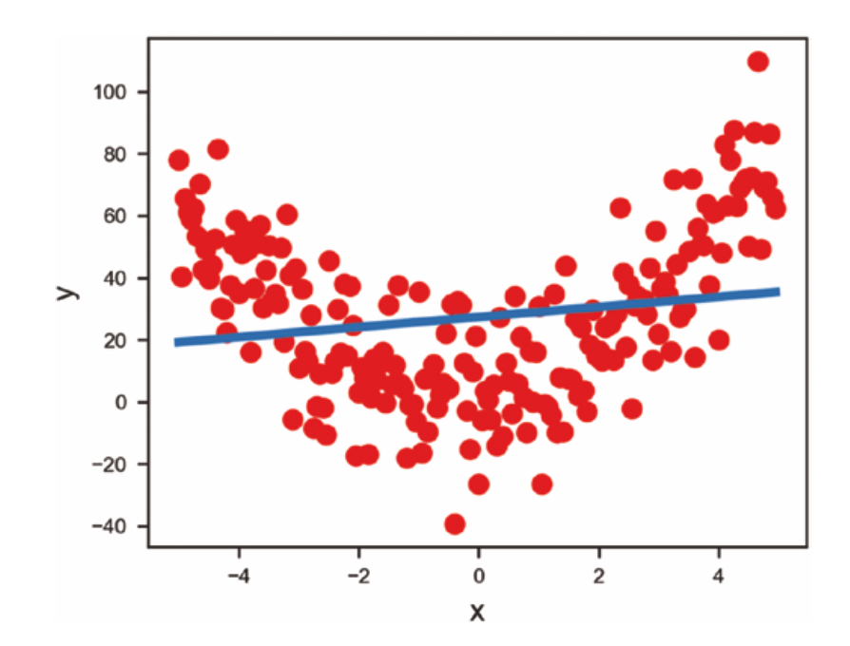
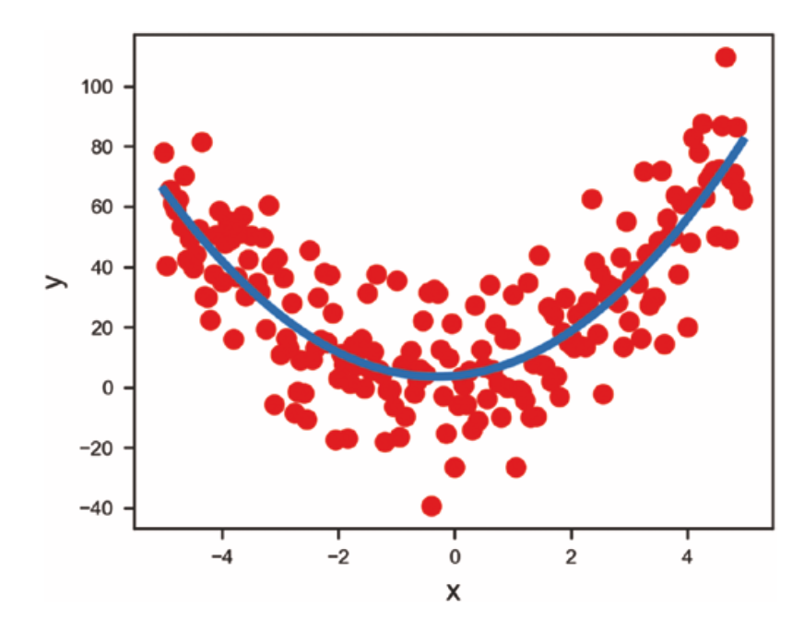
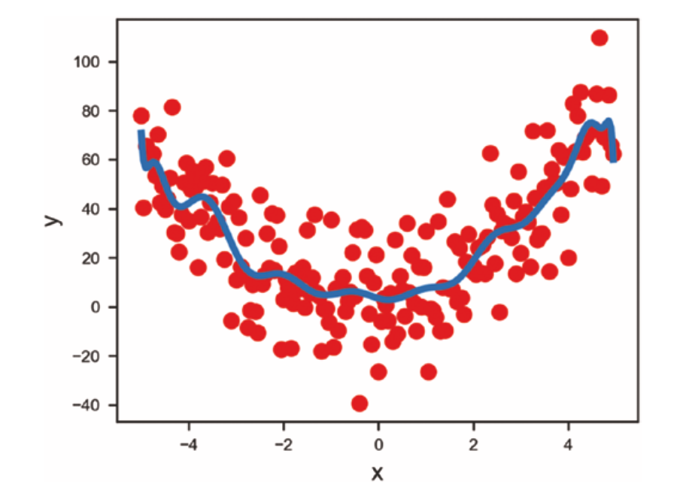
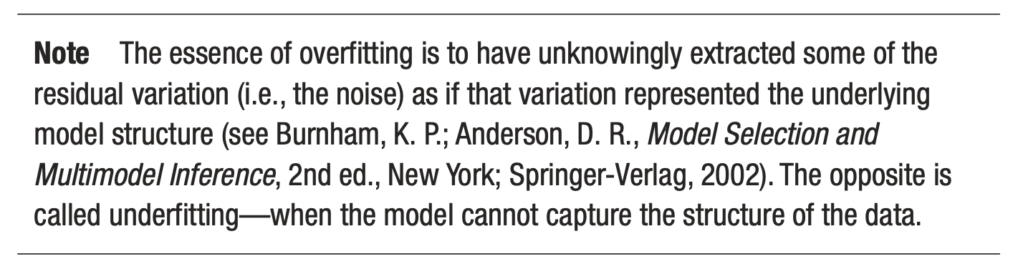
First problem - overfitting
Source:Umberto Michelucci, Applied Deep Learning - A Case-Based Approach to Understanding Deep Neural Networks, APRESS 2018
Underfitting
Just fitting ;-)
Overfitting

Slide 27
Optimizers

Slide 28
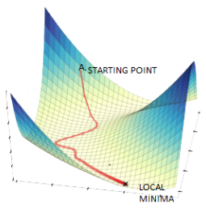
Gradient Descent
Image source: https://www.datasciencecentral.com/alternatives-to-the-gradient-descent-algorithm/, Accessed on 20/8/2022

Slide 29
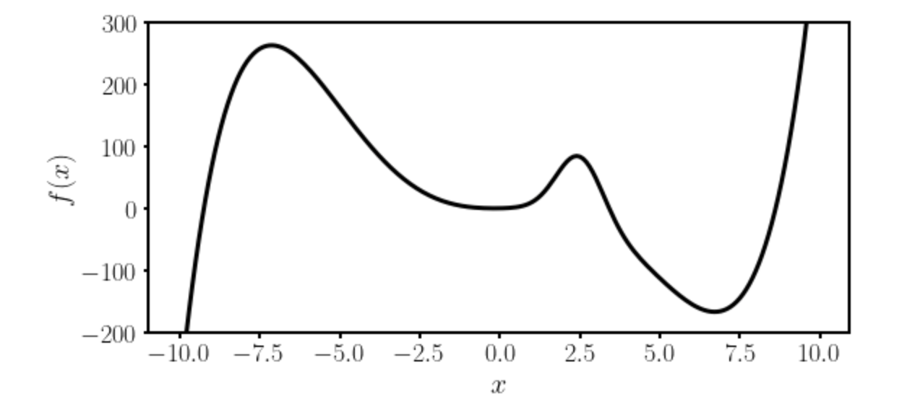
Gradient Descent I
Local minimum
Absolute minimum
Let’s suppose we want to find the absolute minimum of a given function $f(x)$.

Slide 30
Gradient Descent II
There is no analytical solution to the position of the absolute minimum for a network function.
Thus numerical methods are required.

Slide 31

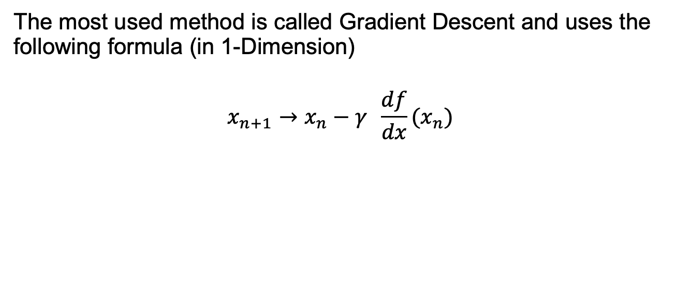
Gradient Descent III
The most used method is called Gradient Descent and uses the following formula (in 1-Dimension)
$$x_{n+1}→x_{n}−γ \frac{df}{dx}(x_{n})$$
Slope of the
function to be
minimized
New minimum location
approximation
Previous minimum location
approximation
Learning rate
The starting point $x_{0}$ is crucial.
Which one should we choose? Does it make a difference?

Slide 32

Gradient Descent IV
Update slow (slope is near zero)
Very fast update
Slope of the
function to be
minimized
$$x_{n+1}→x_{n}−γ \frac{df}{dx}(x_{n})$$

Slide 33
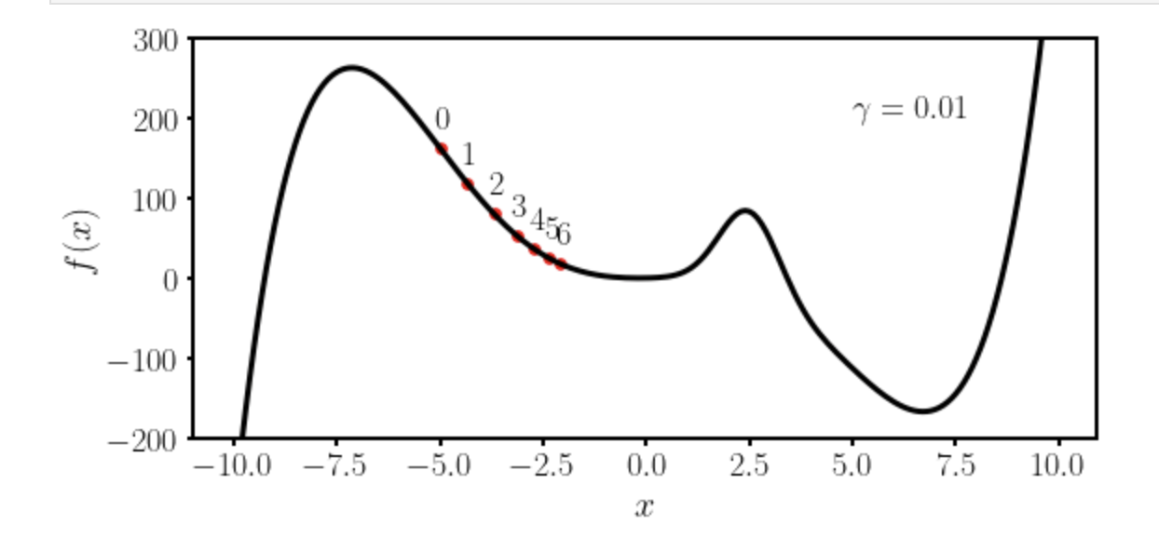
Gradient Descent V
Let’s suppose we want to find the absolute minimum of a given function $f(x)$.
We choose $x_{0}=−5$ and $γ=0.01$

Slide 34
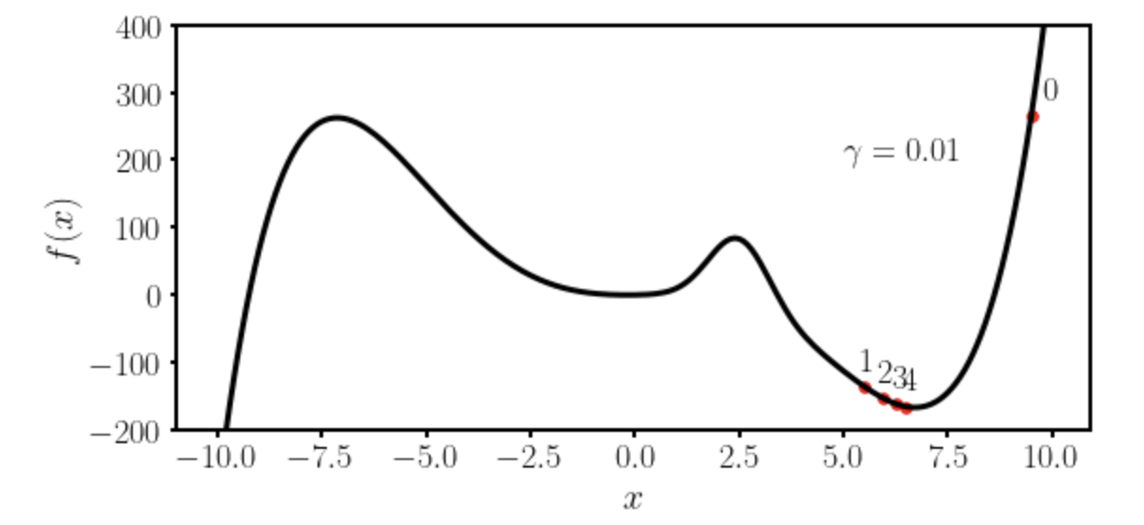
Gradient Descent VI
Let’s suppose we want to find the absolute minimum of a given function $f(x)$.
We choose $x_{0}=−9.5$ and $γ=0.01$

Slide 35
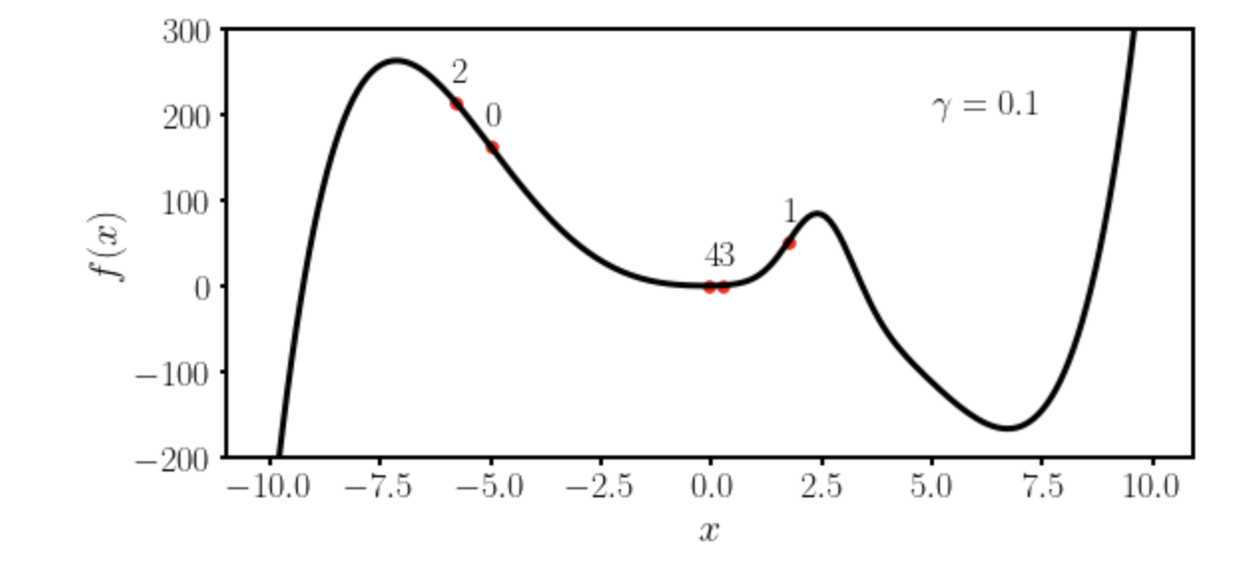
Gradient Descent VII
Let’s suppose we want to find the absolute minimum of a given function $f(x)$.
We choose $x_{0}=−5$ and $γ=0.1$

Slide 36
Some remarks about gradient descent
To use gradient descent you will need the derivative (or gradient in multiple dimensions) of the function you want to minimize.
Due to this reason methods as autodifferentiations and back-propagations have been developed to be able to calculate the derivative of a generic network function.
→ Gradient descent is not the most efficient way of finding minima. It gets easily stuck in local minima. More advanced optimisers have been developed and are typically used (see Adam).

Slide 37
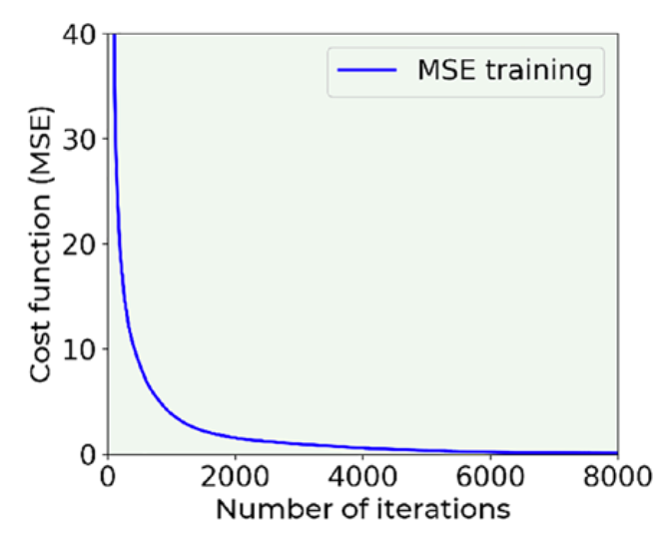
How to check learning
The most fundamental way of checking learning is to plot the loss function vs. the number of iterations. Always do that!

Slide 38
First challenge: the right learning rate
https://www.benfrederickson.com/numerical-optimization/

Slide 39
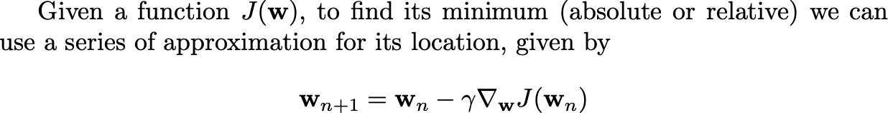
Gradient Descent in many dimensions
For those of you with more mathematical and programming background here is an implementation from scratch of the gradient descent: http://adl.toelt.ai/gradientDescent/Gradient_descent_developed_from_scratch.html

Slide 40
Optimizers
Gradient Descent
RMSProp
Adam
And many others…

Slide 41
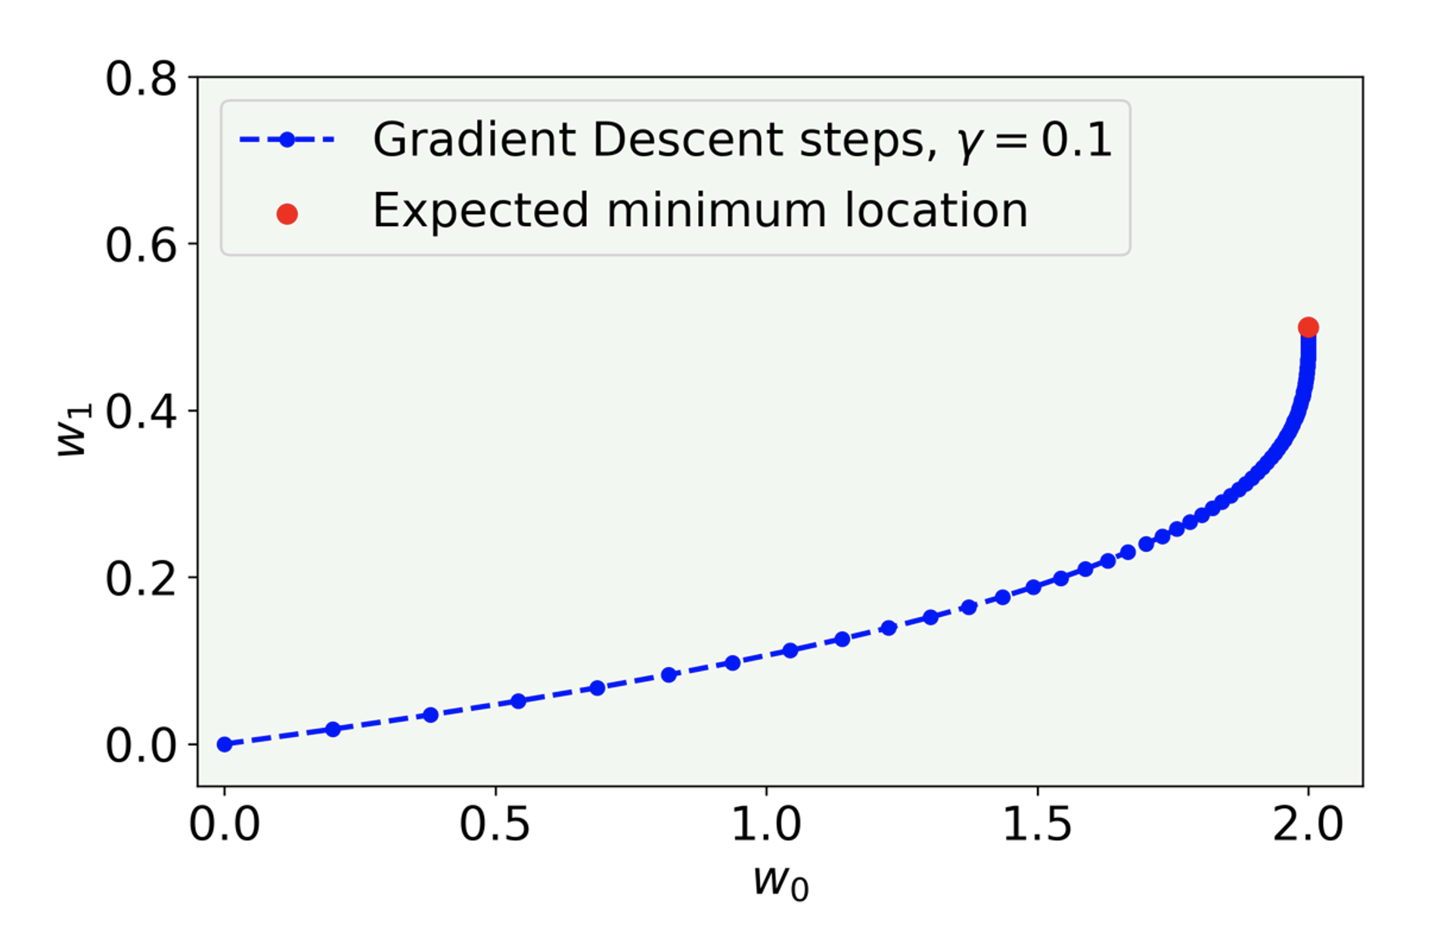
Comparison of algorithms in 2D
U. Michelucci, Applied Deep Learning with TensorFlow 2, Springer Nature, 2022

Slide 42
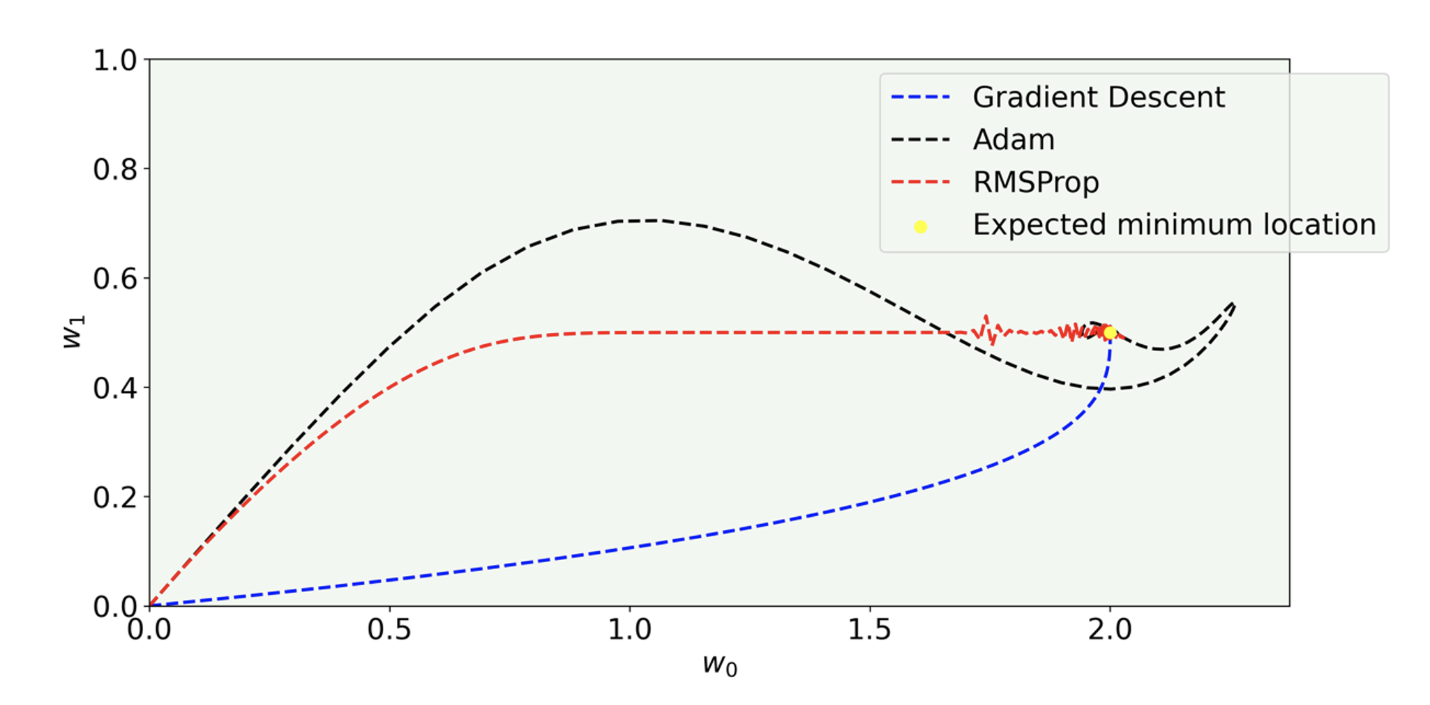
Comparison of algorithms in 2D
U. Michelucci, Applied Deep Learning with TensorFlow 2, Springer Nature, 2022

Slide 43
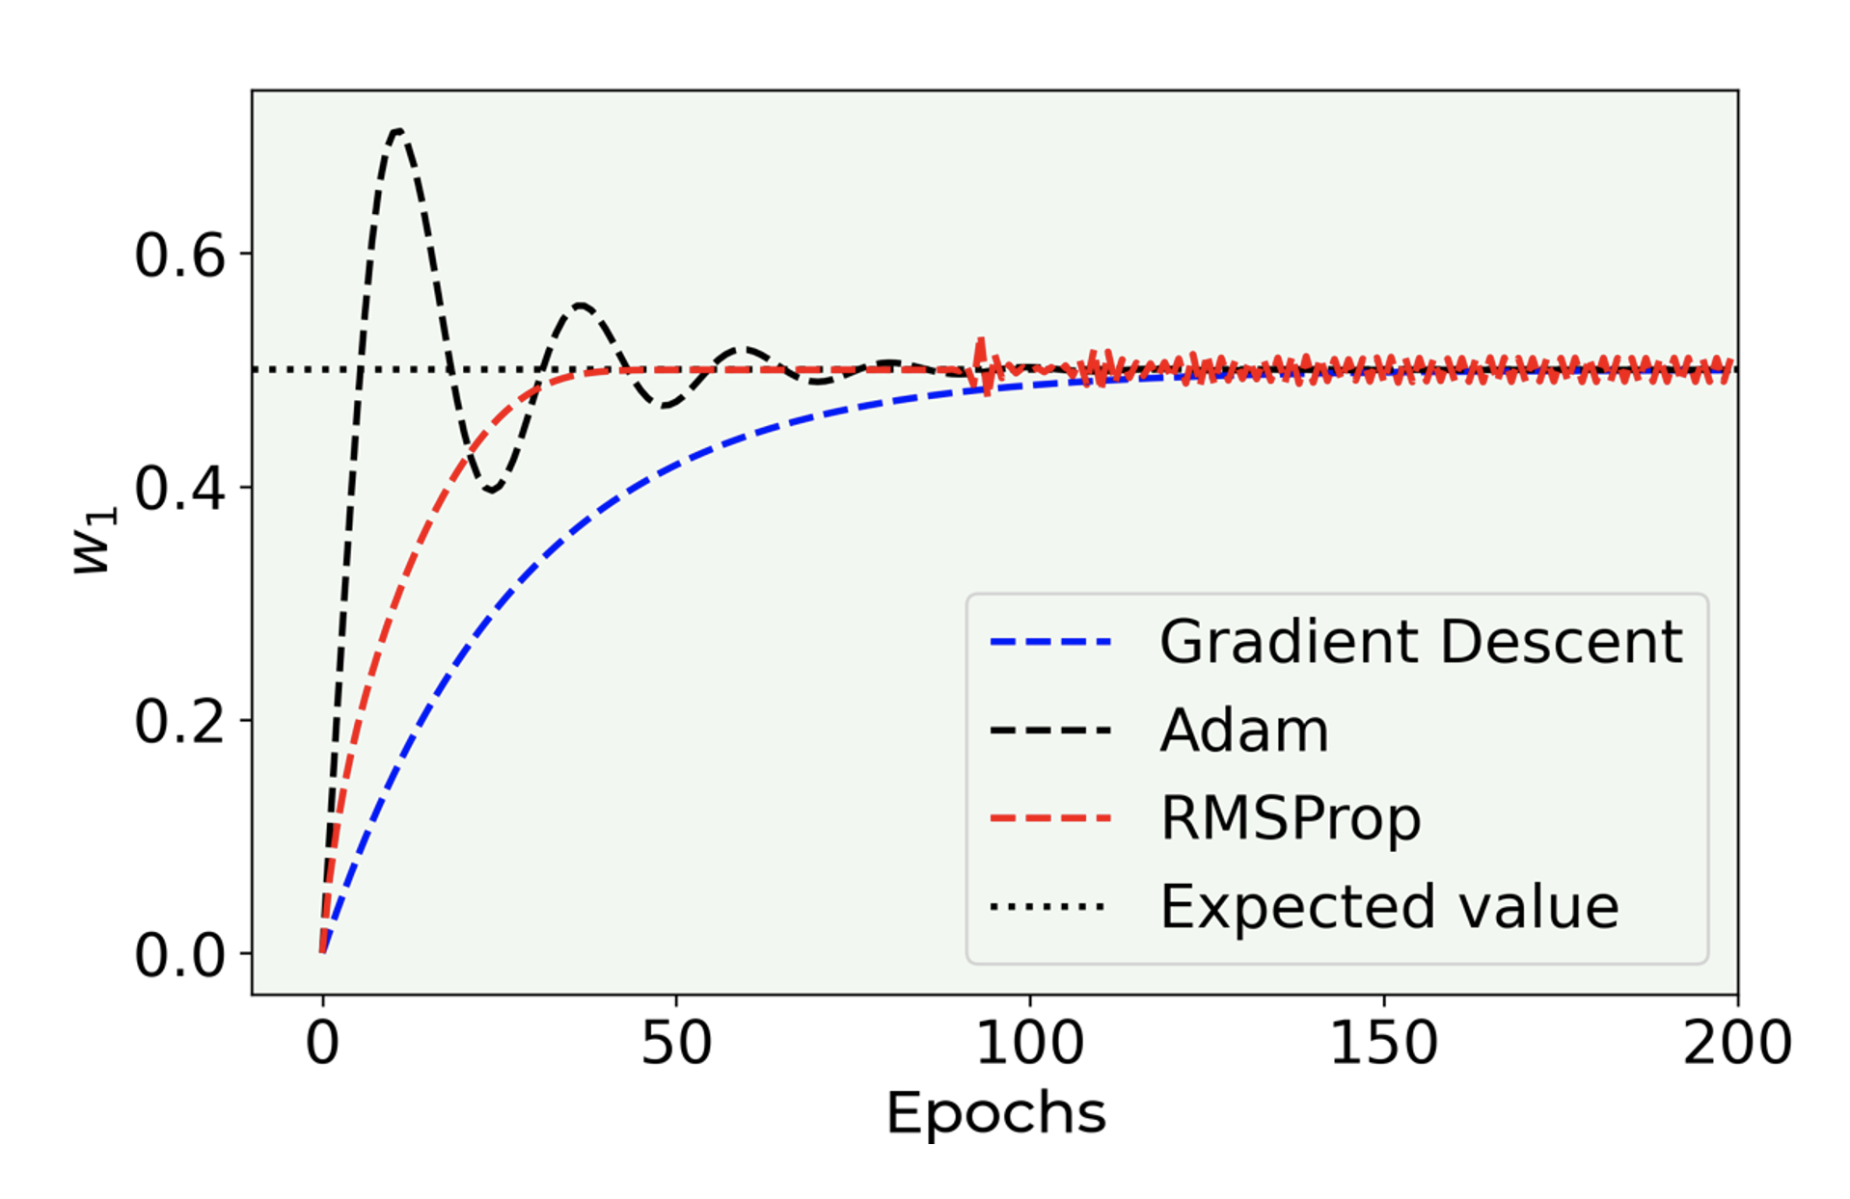
Comparison of algorithms in 2D
U. Michelucci, Applied Deep Learning with TensorFlow 2, Springer Nature, 2022

Slide 44
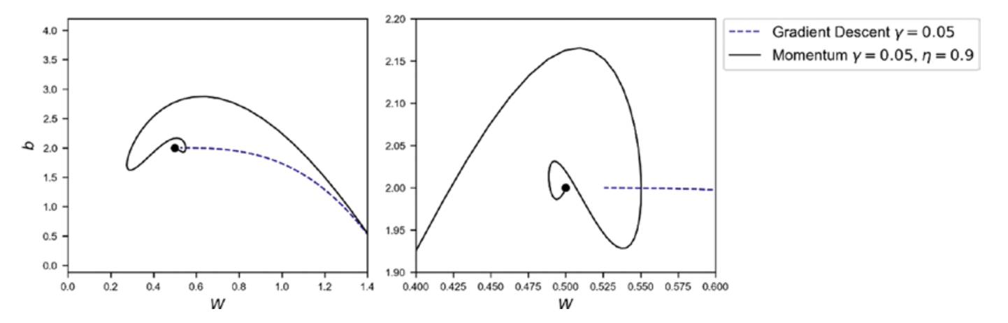
Comparison of algorithms in 2D
Source:Umberto Michelucci, Applied Deep Learning - A Case-Based Approach to Understanding Deep Neural Networks, APRESS 2018

Slide 45
Challenges with Neural Networks

Slide 46
Additional difficulties
Regularisation – How to avoid overfitting and make the models generalize better
Hyperparameter tuning - finding the best parameters to obtain the best values for the chosen metric
Metric analysis - detecting possible issues with the datasets
Training speed - optimizing to get the fastest training possible
Big datasets - working with amount of data that does not fit in memory anymore

Slide 47
Additional architectures
There are many architectures that are know to work best with different data types:
Convolutional neural networks: for multi-dimensional data types (as images)
Recurrent neural networks: time series, language, etc.
Many others have been developed to solve specific problem as: object localisation, segmentation (in MRI for example), etc.

Slide 48
Hands-on Session
https://playground.tensorflow.org

Slide 49
From here the only limit is your creativity!

